Slide 1

Welcome to MKT1705X Principles of Marketing
Lecture 1

Slide 2
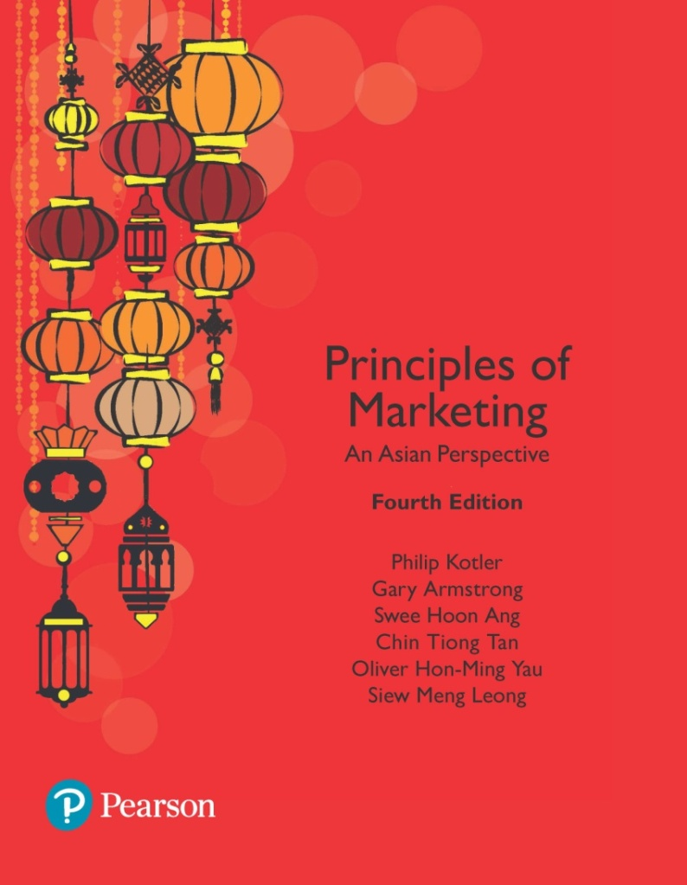
Principles of Marketing: An Asian Perspective Fourth Edition
Chapter 1
Marketing: Managing Profitable Customer Relationships
Copyright © 2018 Pearson Education, Ltd. All Rights Reserved

Slide 3
Learning Objectives
Define marketing and outline the steps in the marketing process.
Explain the importance of understanding the customers and marketplace and identify the five core marketplace concepts.
Identify the key elements of a customer-driven marketing strategy and discuss the marketing management orientations that guide marketing strategy.
Discuss customer relationship management and identify strategies for creating value for customers and capturing value from customers in return.
Describe the major trends and forces that are changing the marketing landscape in this age of relationships.

Slide 4
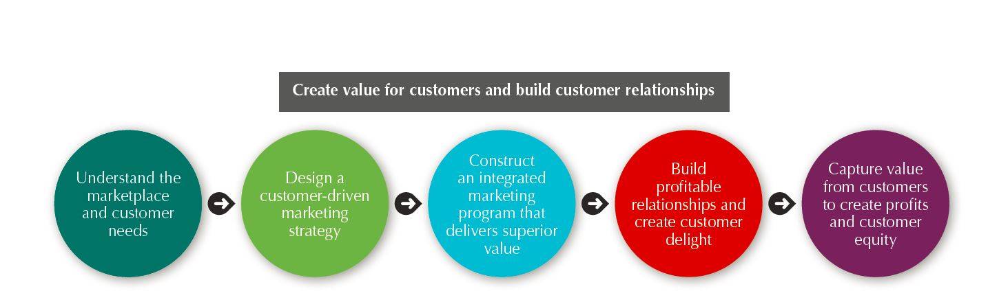
What Is Marketing?
Marketing Defined
Marketing is a process by which companies create value for customers and build strong customer relationships in order to capture value from customers in return.
The Marketing Process

Slide 5
Understanding the Marketplace and Customer Needs
Customer Needs, Wants, and Demands
Needs
States of perceived deprivation
Wants
Form that human needs take
Demands
Wants backed by buying power

Slide 6
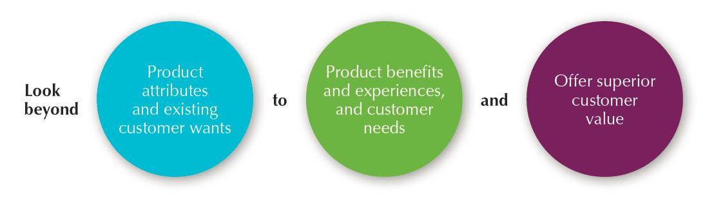
Understanding the Marketplace and Customer Needs
Market Offerings — Products, Services, and Experiences
Market offerings are a combination of products, services, information, or experiences offered to a market to satisfy a need or want, not limited to physical products.
Marketing myopia is focusing only on existing wants and losing sight of underlying consumer needs.

Slide 7
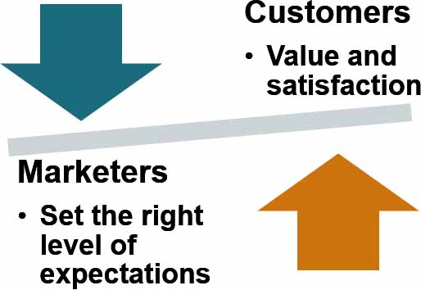
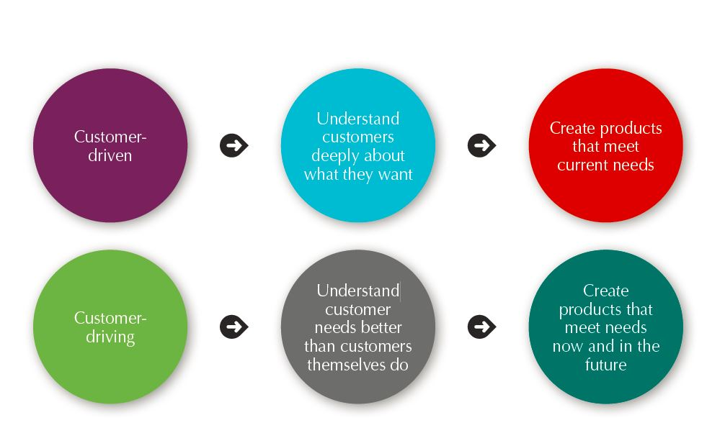
Understanding the Marketplace and Customer Needs
Customer Value and Satisfaction

Slide 8
Designing a Customer-Driven Marketing Strategy
Selecting Customers to Serve
Marketing management is the art and science of choosing target markets and building profitable relationships with them.
What customers will we serve?
How can we best serve these customers?
Market segmentation refers to dividing the markets into segments of customers.
Target marketing refers to which segments to go after.

Slide 9
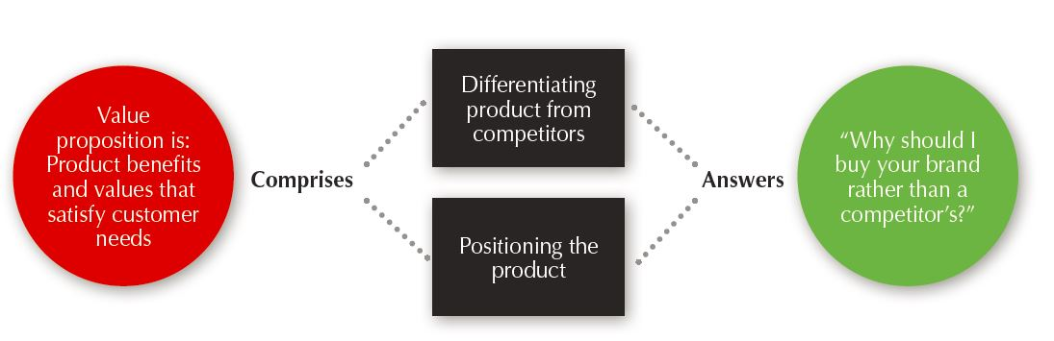
Designing a Customer Value-Driven Marketing Strategy
Choosing a Value Proposition
A brand’s value proposition is the set of benefits or values it promises to deliver to customers to satisfy their needs.
Figure 1.4 What is a Value Proposition?

Slide 10
Designing a Customer Value-Driven Marketing Strategy Marketing Management Orientations
Production Concept
Consumers will favor products that are available and highly affordable.
Product Concept
Consumers favor products that offer the most quality, performance, and features.
Selling Concept
Consumers will not buy enough of the firm’s products unless the firm undertakes a large-scale selling and promotion effort.
Marketing Concept
Societal Marketing Concept
The company’s marketing decisions should consider consumers’ wants, the company’s requirements, consumers’ long-run interests, and society’s long-run interests.
Focus is on continuous product improvements.
Know the needs and wants of the target markets and deliver the desired satisfactions better than competitors.
Marketing Management Orientations

Slide 11
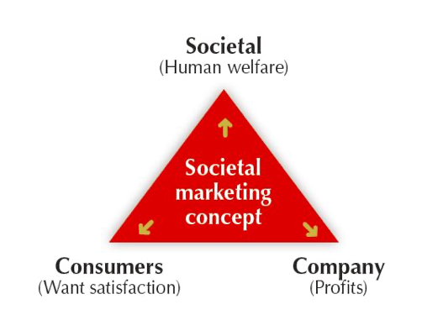
Designing a Customer Value-Driven Marketing Strategy Marketing Management Orientations

Slide 12

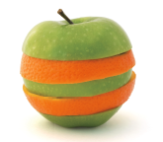
Preparing an Integrated Marketing Plan and Program
The marketing mix is the set of tools (four Ps) the firm uses to implement its marketing strategy. This set includes product, price, promotion, and place.
An integrated marketing program is a comprehensive plan that communicates and delivers the intended value to chosen customers.

Slide 13
Principles of Marketing: An Asian Perspective
Fourth Edition
Chapter 2
Company and Marketing Strategy
Copyright © 2018 Pearson Education, Ltd. All Rights Reserved

Slide 14

The Changing Marketing Landscape
Digital Age: online, mobile and social media marketing
Not-for-profit marketing growth
Rapid globalization
Sustainable marketing

Slide 15
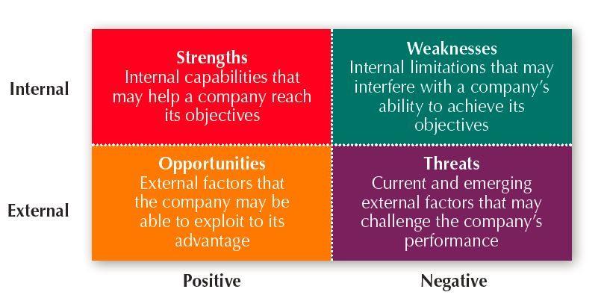
Managing the Marketing Effort
Market Planning—Parts of a Marketing Plan
Executive summary
Situation Analysis
SWOT
Competitor Analysis
Objectives and issues
Marketing strategy
Action programs
Budgets
Controls

Slide 16
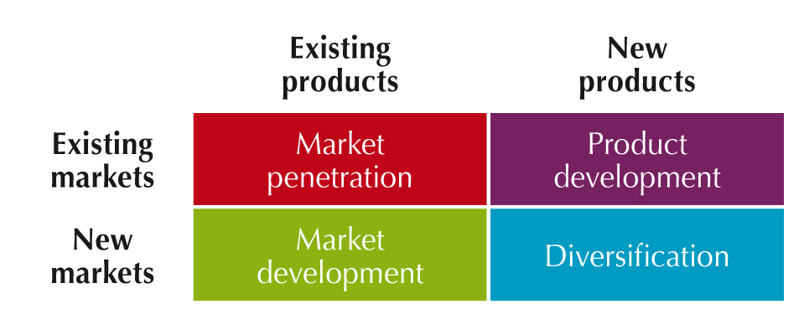
MARKETING OPPORTUNITIES - cont’d
2. Growth Strategies
Market Penetration
Increase sales from present customers in existing markets
Market Development
Identify new segments for current products
Product Development
Offer modified or new products to present customers
Diversification
Acquire or start businesses unrelated to present products & markets

Slide 17
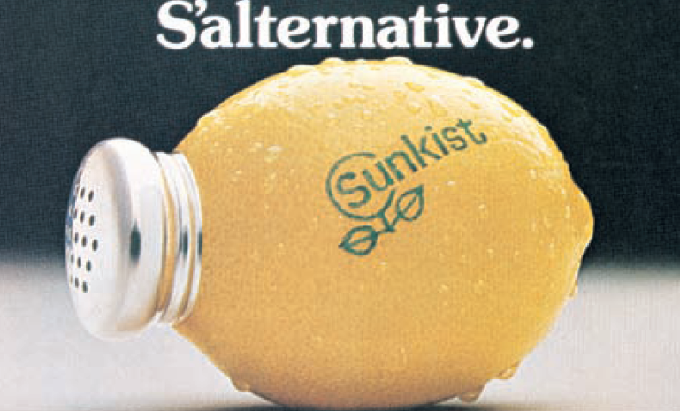
(Ansoff) market-product grid featuring the humble lemon

Slide 18
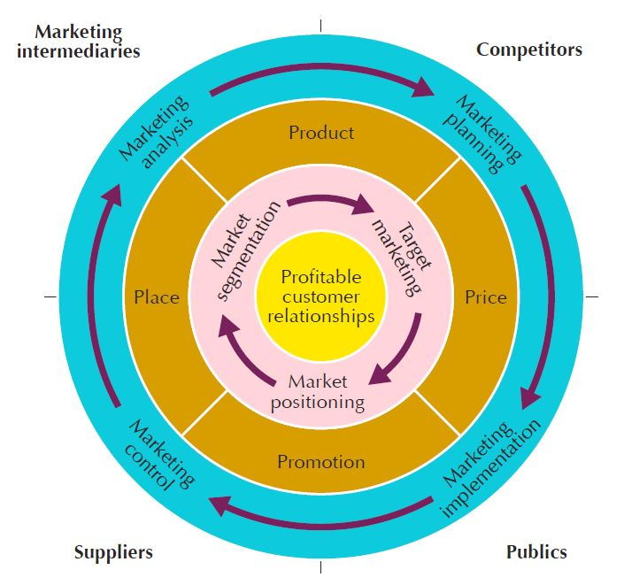
Marketing Strategy and the Marketing Mix
Customer-Driven Marketing Strategy
Marketing strategy is the marketing logic by which the company hopes to create customer value and achieve profitable customer relationships.

Slide 19
Marketing Strategy and the Marketing Mix
Customer Value-Driven Marketing Strategy
Market segmentation is the division of a market into distinct groups of buyers who have different needs, characteristics, or behaviors and who might require separate products or marketing mixes.
Market segment is a group of consumers who respond in a similar way to a given set of marketing efforts.
Market targeting is the process of evaluating each market segment’s attractiveness and selecting one or more segments to enter.
Market positioning is the arranging for a product to occupy a clear, distinctive, and desirable place relative to competing products in the minds of target consumers.
Differentiation begins the positioning process.

Slide 20
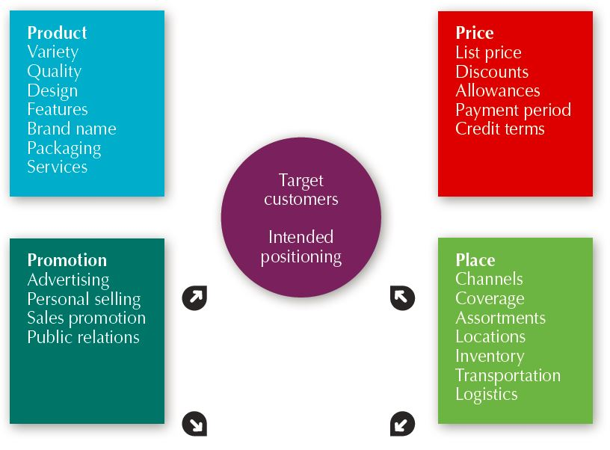
Marketing Strategy and the Marketing Mix
Developing an Integrated Marketing Mix
Marketing mix is the set of controllable, tactical marketing tools—product, price, place, and promotion—that the firm blends to produce the response it wants in the target market.

